Slide 1
Using Probabilistic Models for Data Management in Acquisitional Environments
Sam Madden
MIT CSAIL
With Amol Deshpande (UMD), Carlos Guestrin (CMU)

Slide 2
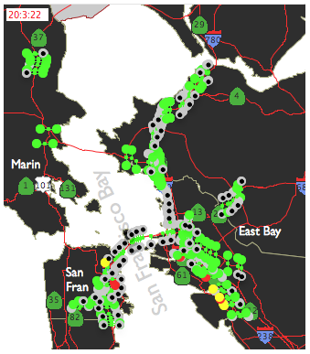
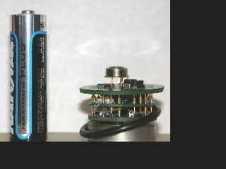
Overview
Querying to monitor distributed systems
  Sensor-actuator networks
  Distributed databases
Berkeley Mote
Distributed P2P
Issues
  Missing, uncertain data
  High acquisition, querying costs
I’m not proposing
a complete
system!
Probabilistic models provide a framework for dealing with all of these issues
Notes:
web querying

Slide 3
Outline
Motivation
Probabilistic Models
New Queries and UI
Applications
Challenges and Concluding Remarks

Slide 4
Outline
Motivation
Probabilistic Models
New Queries and UI
Applications
Challenges and Concluding Remarks

Slide 5
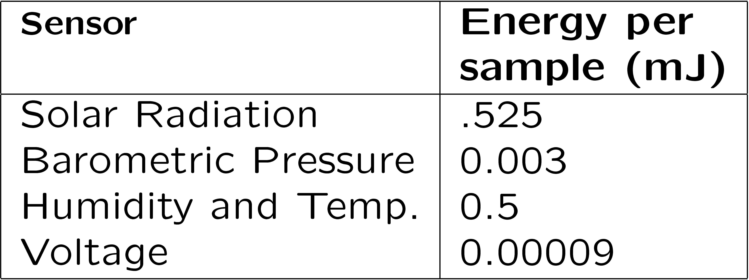
Not your mother’s DBMS
Data doesn’t exist apriori
  Acquisition in DBMS
Insufficient bandwidth
  Selective observation
Sometimes, desired data is unavailable
  Must be robust to loss
Critical issue: given limited amount of noisy, lossy data, how can users interpret answers?
Notes:
make this more about problems in current database architecture

Slide 6
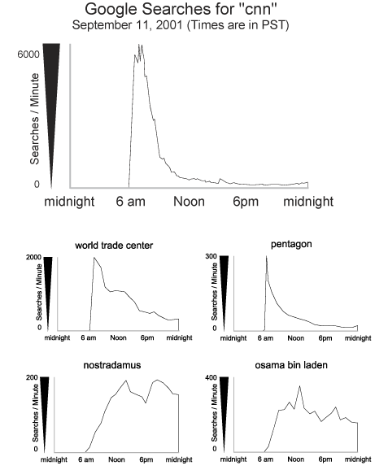
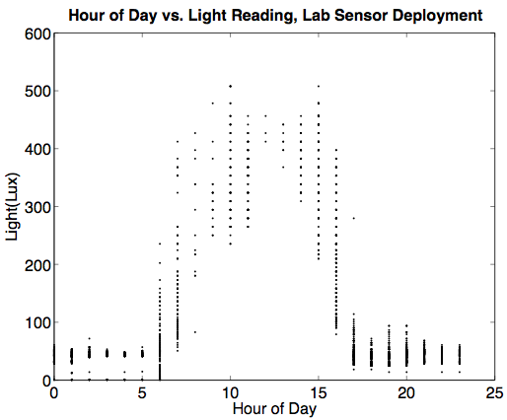
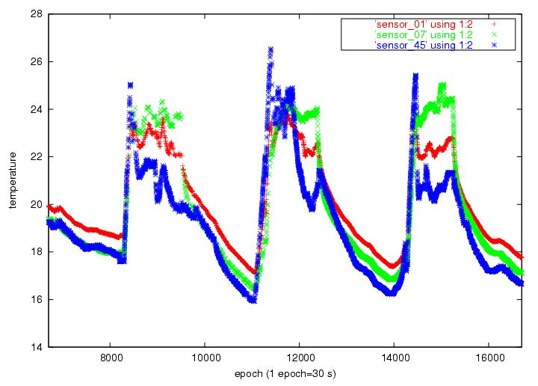
Data is correlated
Source: Google.com
Temperature and voltage
Temperature and light
Temperature and humidity
Temperature and time of day
etc.

Slide 7
Outline
Motivation
Probabilistic Models
New Queries and UI
Applications
Challenges and Concluding Remarks

Slide 8
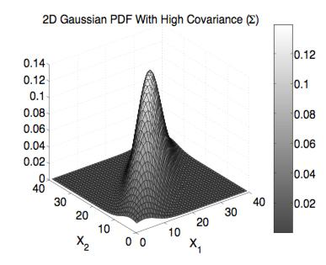
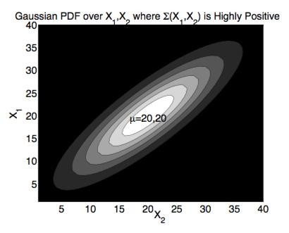
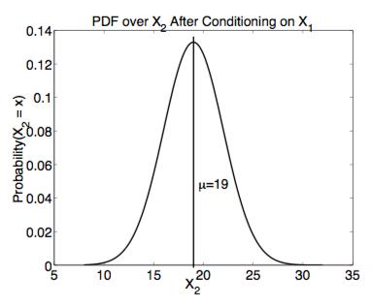
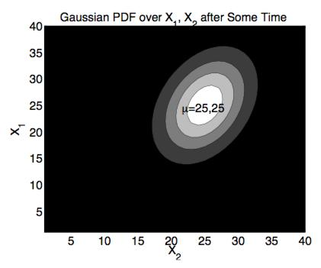
Solution: Probabilistic Models
Probability distribution (PDF) to estimate current state
Model captures correlation between variables
Directly answer queries from PDF
Incorporate new observations
  Via probabilistic inference on model
Model the passage of time
  Via transition model (e.g., Kalman filters)
Models learned from historical data
t₁
t₀
t₀
t₁
Transition Model
Transition Model
Notes:
mention loss here

Slide 9
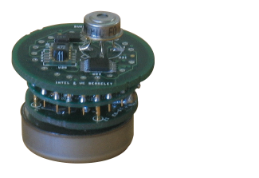
Architecture: Model-driven Sensornet DBMS
posterior belief
Probabilistic
Model
New Query
Query
Advantages vs. “Best-Effort Query-Everything”
Observe fewer attributes
Exploit correlations
Reuse information between queries
Directly deal with missing data
Answer more complex (probabilistic) queries
“SELECT nodeid,temp
FROM sensors
CONF .95 TO ± .5°”
Data
gathering
plan
Condition
on new
observations
Δt
Notes:
label axes

Slide 10
Outline
Motivation
Probabilistic Models
New Queries and UI
Applications
Challenges and Concluding Remarks

Slide 11
New Types of Queries
Architecture enables efficient execution of many new queries
Approximate queries
  “Tell me the temperature to within ± .5 degrees with 95% confidence?”
Query
SELECT nodeId, temp ± 0.5°C, conf(.95) FROM sensors
WHERE nodeId in {1..8}
System selects and observes subset of avail. nodes
Observed nodes: {3,6,8}
Query result
Node | 1 | 2 | 3 | 4 | 5 | 6 | 7 | 8
Temp. | 17.3 | 18.1 | 17.4 | 16.1 | 19.2 | 21.3 | 17.5 | 16.3
Conf. | 98% | 95% | 100% | 99% | 95% | 100% | 98% | 100%
Notes:
play up novelty, mention missing

Slide 12
Probabilistic Query Optimization Problem
What observations will satisfy confidence bounds at minimum cost?
  Must define cost metric and model
    Sensornets: metric = power, cost = sensing + comm
  Decide if a set of observations satisfies bounds
  Choose a search strategy

Slide 13
Choosing observation plan
Query Predicate
Is a subset S sufficient?
P(X_{i}[a,b]) > 1-δ
If we observe S =s :
R_{i}(s ) = max{ P(X_{i}[a,b] | s ),
1-P(X_{i}[a,b] | s )}
reward
Value of S is unknown:
∫
R_{i}(S ) = P(s ) R_{i}(s ) ds
Optimization problem:
Pick your favorite search strategy

Slide 14
More New Queries
Outlier queries
  “Report temperature readings that have a 1% or less chance of occurring.”
Extend architecture with local filters:
Update Models
Central Model
User
Transmit Outliers
Issues:
Bias
Inefficiency
10
20
30
10
20
30
10
20
30
10
20
30
Local Models
10
20
30
10
20
30
10
20
30
10
20
30
10
20
30
10
20
30
Notes:
issues: bias, efficiency

Slide 15
Even More New Queries
Prediction queries
  “What is the expected temperature at 5PM today, given that it is very humid?”
Influence queries
  “What percentage of network traffic at site A is explained by traffic at sites B and C?”
Queries could not be answered without a model!

Slide 16
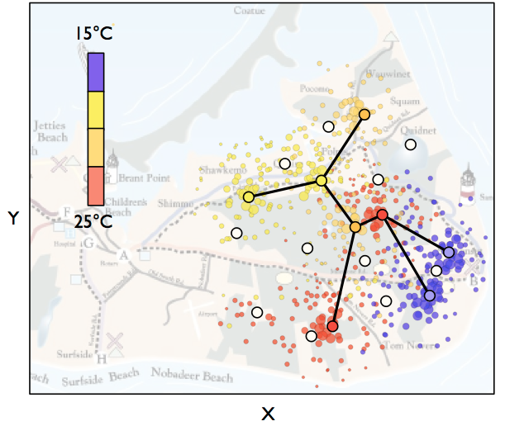
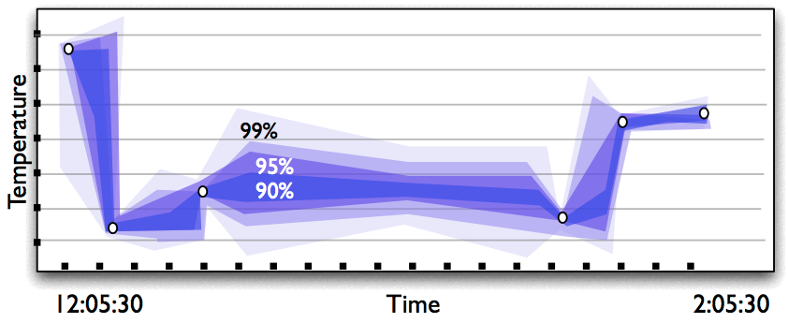
UI Issues
How to make probability “intuitive”?
How to allow users to express queries?
Issues
  Query Language
  UI
Load vs. Time

Slide 17
Outline
Motivation
Probabilistic Models
New Queries and UI
Applications
Challenges and Concluding Remarks

Slide 18
Applications
Sensor-based Building Monitoring
  Often battery powered
  100s-1000s of nodes
Example: HVAC Control
  Tolerant of approximate answers
  Reduction in energy significant

Slide 19
App: Distributed System Monitoring
Goal: detect/predict overload, reprovision
Many metrics that may indicate overload
  Disk usage, CPU load, network load, network latency, active queries, etc.
  Cost to observe
Problem: What metrics foreshadow overload?
Soln:
  Train on data labeled w/ overload status
  Choose obs. plan that predicts label

Slide 20
Other Apps
Stream load shedding
Sensor network intrusion detection
Database statistics
See paper!

Slide 21
Outline
Motivation
Probabilistic Models
New Queries and UI
Applications
Challenges and Concluding Remarks

Slide 22
Extension, Not Restriction
Possible to have many views of same data
  Different models
  Base data
Query
Query
Integration Layer
Model 1
Model 2
Discrete (Histograms)
Gaussians
Acquisition Layer + Tabular Data
System State
Number of architectural challenges

Slide 23
Every rose…
Models can can fail to capture details
Models can be wrong
Models can be expensive to build
Models can be expensive to maintain
Paper suggests a number of known techniques from the ML community.

Slide 24
Whither hence?
See the paper for technical details
See other work
  Probabilistic data models
  Outlier and change detection
Generalize these ideas to:
  New models
  Non-numeric types
  New environments, queries
Make some AI and stats friends

Slide 25
Conclusions
Emerging data management opportunities:
  Ad-hoc networks of tiny devices
  Large scale distributed system monitoring
These environments are:
  Acquisitional
  Loss-prone
Probabilistic models are an essential tool
  Tolerate missing data
  Answer sophisticated new queries
  Framework for efficient acquisitional execution

Slide 26
Questions

Slide 27
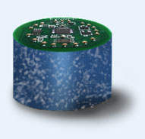
Example: TinyDB
Declarative queries for sensornets
1
1
SELECT roomNo, AVG(temp)
FROM sensors
GROUP BY roomNo
HAVING MAX(light) > 100 lux
SAMPLE PERIOD 1 s
1
2
2
2
3
3
3
4
4
4
5
5
5
Queries flooded, reverse-flood aggregation
Best effort

Slide 28
TinyDB Limitations
Difficult to interpret answers
  Answering nodes can change between samples
Limited queries
  No historical trends
  No future predictions
  No outlier detection
High overhead
  Query flooding, full network traversal
  No information sharing between sample periods

Slide 29
App: Value-Based Load Shedding
User prioritizes some output values over others
  May have to shed load
Issue: what inputs correspond to desired outputs?
  Esp. hard for aggregates, UDFs
Can learn a probabilistic model that gives
  P(output value | input tuple)
  Requires source tuple references on result tuples
Use this model to decide which tuples to drop

Slide 30
Coping with Complexity
Graphical models

Slide 31
Coping with Mistakes
Retraining models

Slide 32
Prior Work
On probabilistic data models / statistics
  Not addressing issue of data acquisition
On using models to decide what to capture
  Tends to focus on performance issues
Our Concerns:
  What data to acquire?
  Interpretability given missing data

